Slide 1

Smart Road Infrastructure
Monitoring System
ESP32-Based Pothole Detection and Maintenance Alert System
01

Slide 2

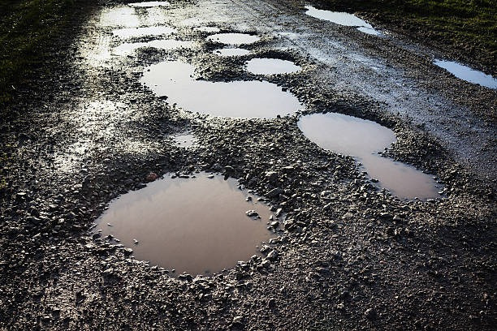
Introduction
  Potholes are a major concern for road safety and vehicle maintenance.
  Traditional road inspections require manual effort and time.
  An automated monitoring system can help identify road damage efficiently.
  Our project uses ESP32 and multiple sensors to detect potholes and monitor road conditions.
  Sensor readings are transmitted wirelessly to a web-based dashboard.
02

Slide 3
Problem Statement
Our Solution:
Develop an loT-based system that detects potholes, estimates their severity, identifies water presence, and supports maintenance tracking.
01
02
Manual pothole identification is time-consuming.
Delayed detection and maintenance increase road safety risks.
03
04
Water-filled potholes are difficult to identify visually.
Lack of continuous monitoring makes maintenance planning challenging.
03

Slide 4

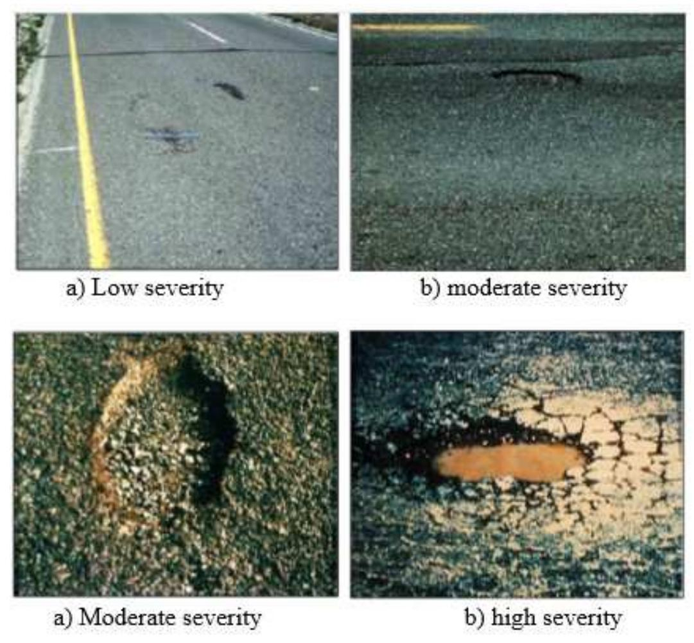
Objectives
01
Detect potholes using an ultrasonic sensor.
02
Estimate pothole depth and classify severity.
03
Identify water presence using a moisture sensor.
04
Estimate vehicle speed using a magnetic sensor.
05
Location information through GPS.
06
Sensor readings on a web dashboard.
07
Maintenance alerts and track repair status.
04

Slide 5

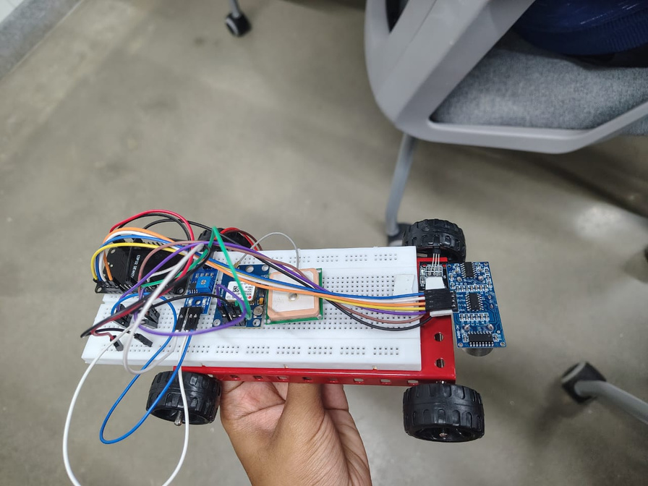
Hardware Components
01
02
ESP32
Ultrasonic Sensor
Main microcontroller and Wi-Fi communication
Measures distance to the road surface
03
04
05
Magnetic Sensor
Moisture Sensor
GPS Module
Counts wheel rotations
Detects water presence
Provides geographical coordinates
05

Slide 6

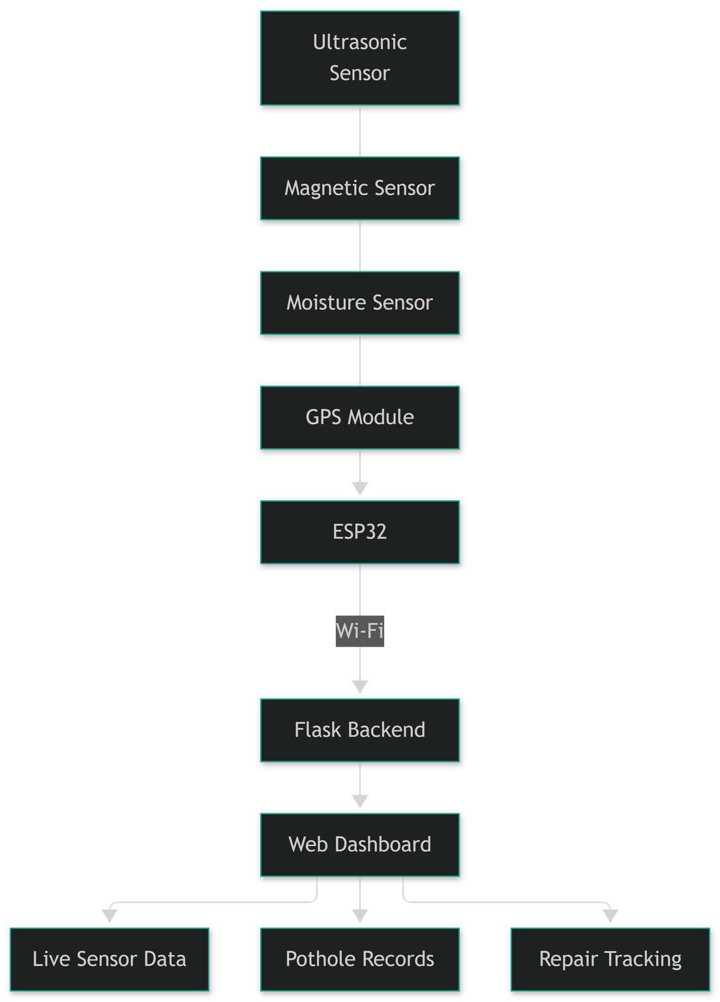
System Architecture
Sensors collect road-condition data, which is processed by the ESP32 and transmitted to the Flask backend through Wi-Fi. The website displays the readings and supports maintenance monitoring.
06

Slide 7
01
02
Working Principle
Road Surface Monitoring
Pothole Detection
03
04
05
Additional Monitoring
Data Transmission
Web Monitoring
07

Slide 8

Software Implementation
Technology
Arduino IDE: ESP32 programming and sensor interfacing.
Embedded C/C++: Sensor processing and pothole detection.
Python Flask: Backend server and API communication.
HTML: Website structure.
CSS: Dashboard design.
JavaScript: Live sensor monitoring and dashboard updates.
Communication
ESP32 sends sensor data to Flask through HTTP POST requests. The website retrieves the latest readings through HTTP GET requests.
08

Slide 9

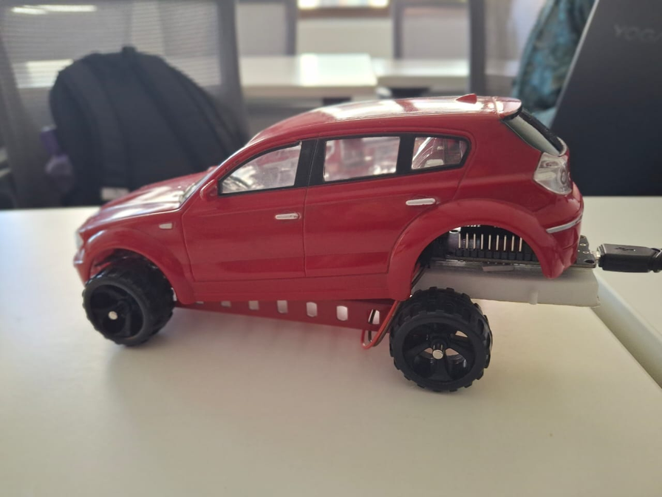
Results and Current Implementation
  Successful ESP32 sensor interfacing.
  Ultrasonic distance and estimated depth measurement.
  Magnetic sensor-based wheel rotation counting.
  Moisture detection.
  GPS integration with simulated-location fallback.
  Successful ESP32-to-Flask communication.
  Live sensor readings displayed on the website.
  Automatic pothole ticket generation.
  Dashboard statistics based on recorded potholes.
  Maintenance status updates.
  Calibration of magnetic sensing and severity thresholds.
09

Slide 10
Conclusion
Future Scope
  Developed an ESP32-based prototype for monitoring road conditions.
  Integrated ultrasonic, magnetic, moisture, and GPS sensors.
  Established wireless communication between the ESP32 and a web dashboard.
  Demonstrated live sensor monitoring and pothole depth estimation.
  Improve pothole detection accuracy through sensor calibration.
  Implement reliable speed-breaker detection.
  Add permanent database storage for pothole records.
  Improve GPS-based location tracking.
  Develop a more robust maintenance management system.
10

Slide 11
Thank You
11

